Slide 1
News Articles Sorting
Author: SACHIN KUMAR G

Slide 2
Project Details:
Project Title | News Articles Sorting
Technologies | Deep Learning Technology(NLP)
Domain | Media
Project Difficulty level | Intermediate
Programming Language | Python

Slide 3
Objective: develop a machine learning-based solution that automatically categorizes news articles into predefined topics or categories, such as Finance, Sports, Politics, and more.
Benefits:
Efficient Information access.
Personalized Content.
Reduced Information Overload.
Timely Updates.
Enhanced User Experience.

Slide 4
Problem Statement: In today’s world, data is power. With News companies having terabytes of data stored in servers, everyone is in the quest to discover insights that add value to the organization. With various examples to quote in which analytics is being used to drive actions, one that stands out is news article classification. Nowadays on the Internet there are a lot of sources that generate immense amounts of daily news. In addition, the demand for information by users has been growing continuously, so it is crucial that the news is classified to allow users to access the information of interest quickly and effectively. This way, the machine learning model for automated news classification could be used to identify topics of untracked news and/or make individual suggestions based on the user’s prior interests.

Slide 5
Approach: Techniques like clustering and associating rule-based algorithms can be applied to group together similar text. The ML algorithms learn the mapping function between the text and the tags based on already categorized data. Algorithms such as NMF (Non-negative Matrix Factorization, Random Forest are commonly used for text classification.

Slide 6
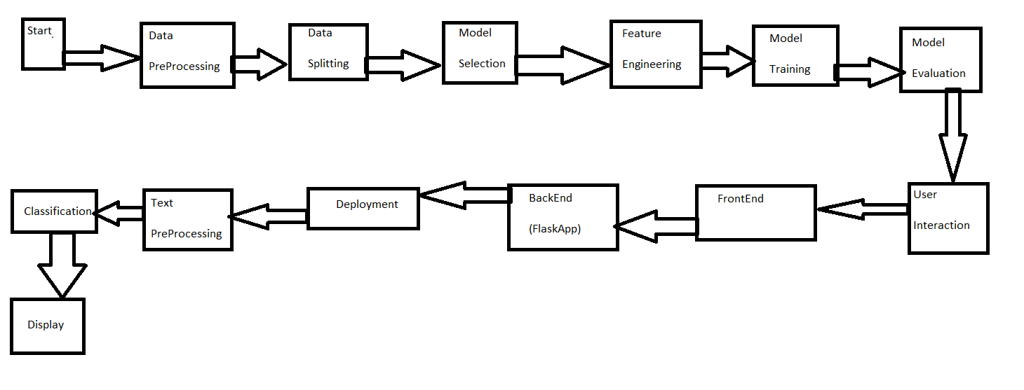
Architecture:

Slide 7

Deployment:

Slide 8
Process:
Step1:- When Flask app is open in search button user enter the category like sport, business etc. based upon user’s interest’s.
Step2:- Then It will classify the News Articles.
Step3:- Preprocessed text is passed through the model for classification.
Step4:- The app displays the predicted category to the user.

Slide 9
Conclusion:
Finally we launch a python flask app for classifying News Articles for
User’s interest’s and it will be free and open source app. And It can be
Used by unknowledgeable person’s also for his personal work.

Slide 10


